Slide 1


Subject
Presentation
Fine Art
Supporting you to make an informed decision
If you have any questions, please contact me on:

Slide 2

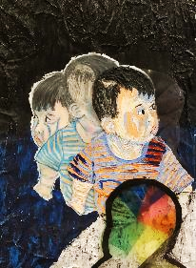


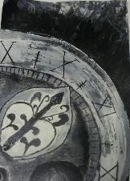
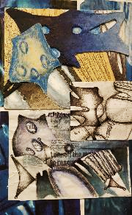
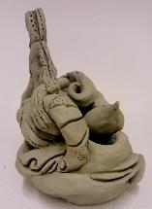
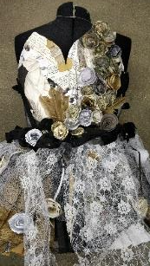
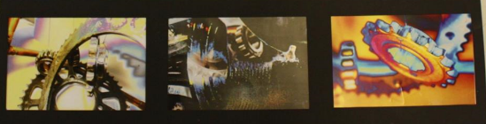
60% Component 1
This is all work from Year 10 until Jan Year 11
One project and a selection of further work
You will get to develop your own project from a series of themes and choose your own artist.
40% Externally set unit
From Jan Year 11 until Easter
A smaller project with themes set by the exam board.
GCSE Fine Art
Fine art
Fine art practice is defined here as the need to explore an idea, convey an experience or respond to a theme or issue of personal significance.
Painting
Ceramics
Drawing
Mixed
media
Is there an exam?
There is a 10 hour exam where you create the final piece – not a written exam.
Photography
Sculpture
Notes:
GCSE Art is very different to KS3 – we work as a team and you work independently. It is about extending your skills not gaining them.
You will create work with personal meaning and use a range of media – not just pencil

Slide 3
2024
Grades 9-7= 15.6% NA:22.6%
Grades 9-4 = 53.1% NA: 75.6%
2023
Grades 9-7 = 30% NA 26.9%
Grades 9-4 = 100% NA 78.1%
2022 – NO EXAM PROJECT
Grades 9-7 = 30% NA 28.2%
Grades 9-4 = 89% NA 81.6%
2021 - TAGS
Grades 9-7 = 26% NA: 30.2%
Grades 9-4 = 68% NA: 84.9%
2020 - CAGS
Grades 9-7 =19% NA: 29.6%
Grades 9-4 =85% NA: 86.5%
2019
Grades 9-7 = 18% NA: 22.8%
Grades 9-4 = 91% NA: 75.2%
Art and Design
GCSE results

Slide 4
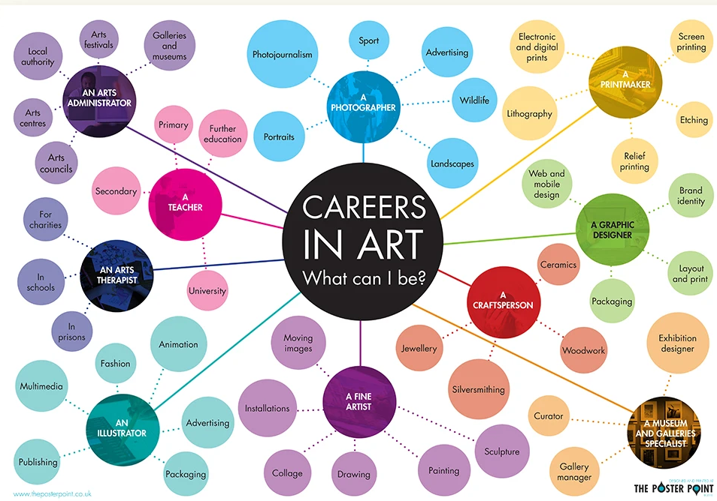

Slide 5
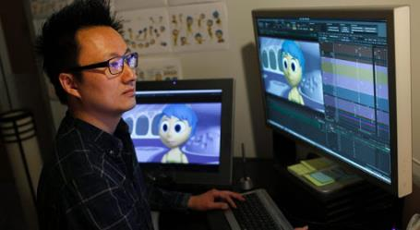
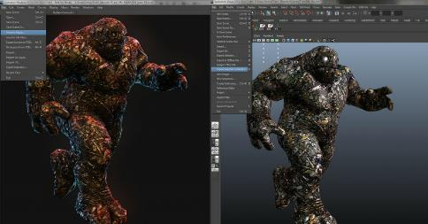
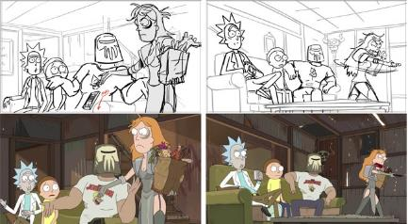
Come and look at the
Arts careers brochure!
Animator
What is an animator?
Qualifications:
An animator produces multiple images called frames, which when sequenced together create an illusion of movement - this is known as animation. The images can be made up of digital or hand-drawn pictures, models or puppets.
Animators tend to work in 2D, 3D model-making, stop-frame or computer-generated animation.
The following degree or foundation degree subjects are most relevant:
animation
art and design
computer-aided engineering
design for moving image
electrical engineering
film and video
graphic design/illustration
model making or sculpture
multimedia
spatial design
3D design
Salary and hours:
What do they do?
Liaising with clients and developing animation concepts
Creating storyboards, sketches and characters (hand drawn then CGI)
Matching sequence of images to the soundtrack and audio
Using technical software packages
Creating detailed frame by frame visuals
Working to production deadlines
Delivering presentations
Collaborating with design team and a wide variety of media companies
Entry salary: £12,000-£15,000
Computer game animation: £18,000
Experienced: £25,000
Ten years+ experience: £36,000
Working hours are regular office hours (approximately 40 hours per week), but as deadlines approach you may need to work overtime, including at the weekend. Flexitime is quite common.

Slide 6
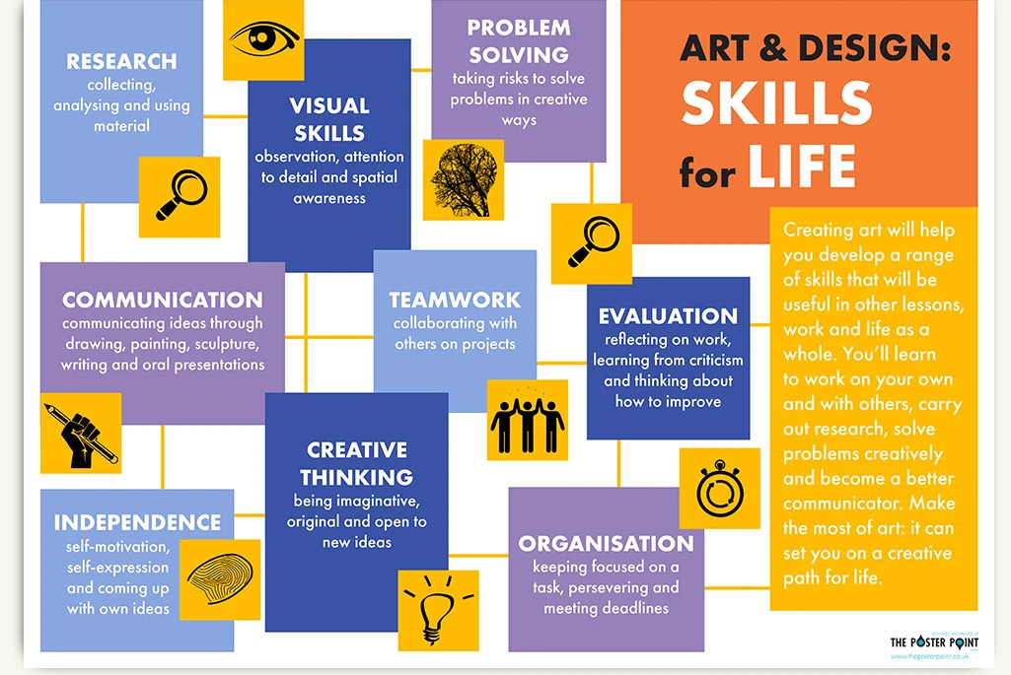

Slide 7
What skills do I need to do an Art GCSE?
Good standard of art skills across different media
Ability to work independently
Commitment to meet deadlines – 2-3 HOURS OF HOMEWORK PER WEEK
Can create work with personal meaning
Organisation
Perseverance to refine your work

Slide 8




What will I be doing in Art?
Do I have to do writing?
YES! But not lots
Analysis of artists
Analysis of your work/ideas
10% writing
20%
Presenting your work
60%
Drawing and using media

Slide 9
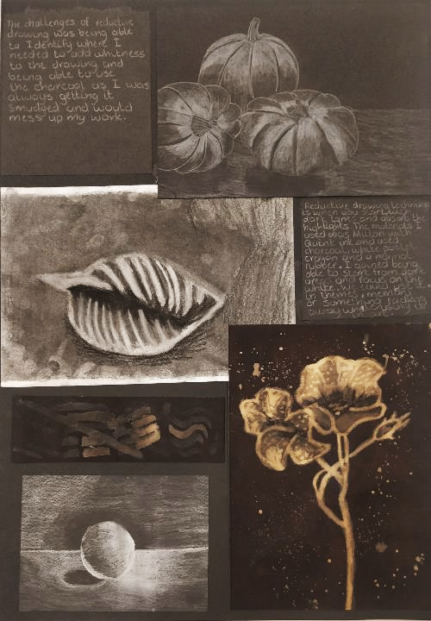
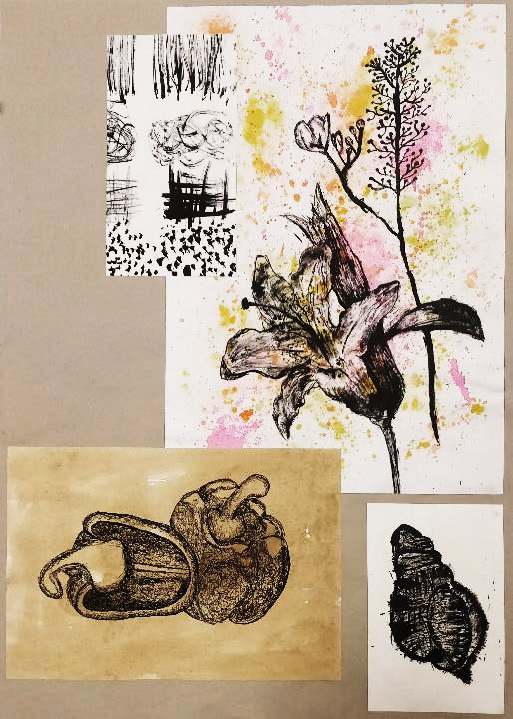
Further work – Autumn Term Year 10

Slide 10
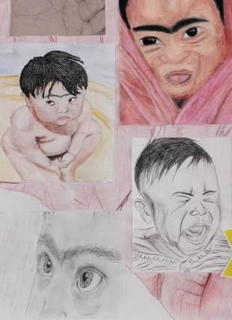
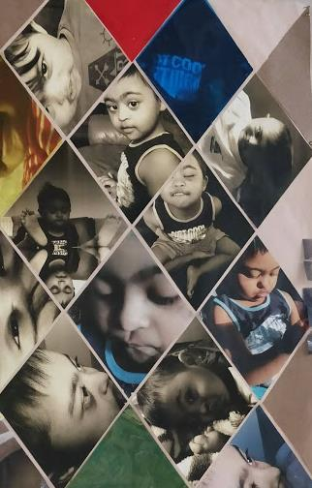
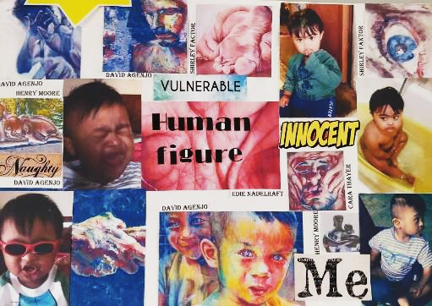
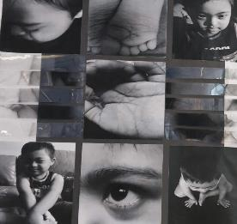
SUSTAINED PROJECT
YEAR 10-11
Drawing sheet
Mind map
Photosheets

Slide 11
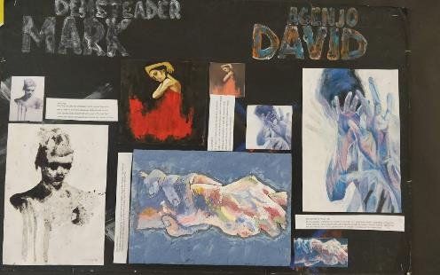
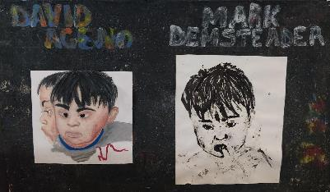
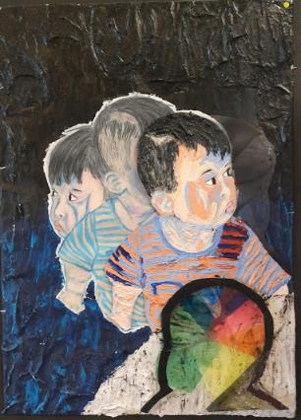
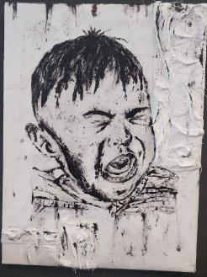
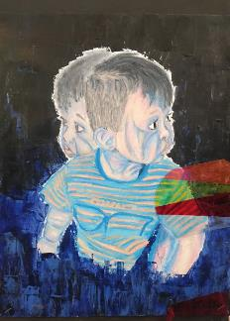
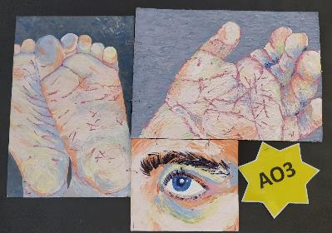
Critical study board
Design idea 1
Design idea 2
Design
idea 3
Final response

Slide 12
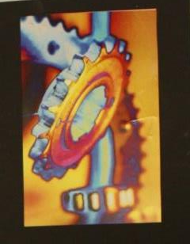
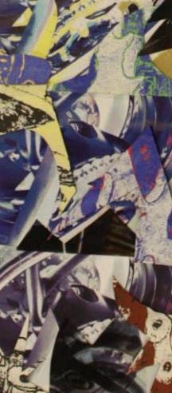
Is there loads of homework?
If Art and Photography are available in separate option blocks then yes, you can select both as options.
Please be aware:
Deadlines for both subjects are the same
Both subjects are coursework heavy and therefore require consistent effort over the whole of the course
Both require commitment to work at home and after school
Exams are likely to take place very closely together – possibly in one week
You can create photography outcomes in the Fine Art course and you can explore practical manipulation in the Photography course.
Can I do Art AND Photography?

