Slide 1



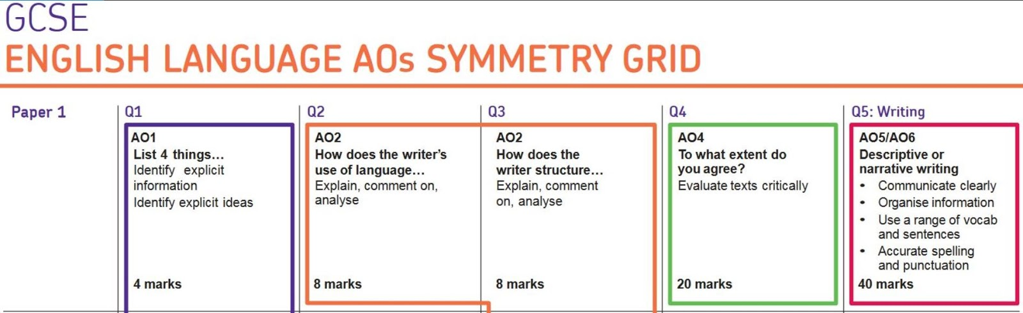
Language Paper 1
Walkthrough
Revision Guide

Slide 2
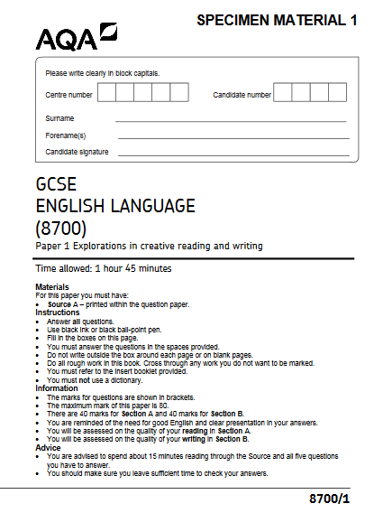


What does Paper 1 look like?
ALWAYS start with Question 5 and work backwards!
Language Paper 1: Fiction (1 hour 45 minutes)
Section A | Reading skills
Question 1 (4 marks) List 4 things. | Read a section of text specified. List and quote 4 things that match the question. 5 minutes
Question 2 (8 marks) How does the writer use language to describe…? | Language analysis: analyse language to explore its effect on the reader. 10 minutes
Question 3 (8 marks) How does the writer structure the text to interest the reader? | Structure analysis: analyse structure to explore its effect on the reader. 10 minutes
Question 4 (20 marks) A student said, “_____”. To what extent do you agree? | Evaluating the extract and its performance using the student’s statement. Analyse language, structure, tone and atmosphere. 20 minutes
Section B | Writing skills
Question 5 (40 marks) | Respond to an image and write a description suggested by it OR write a narrative using the title/topic provided. 45 minutes

Slide 3

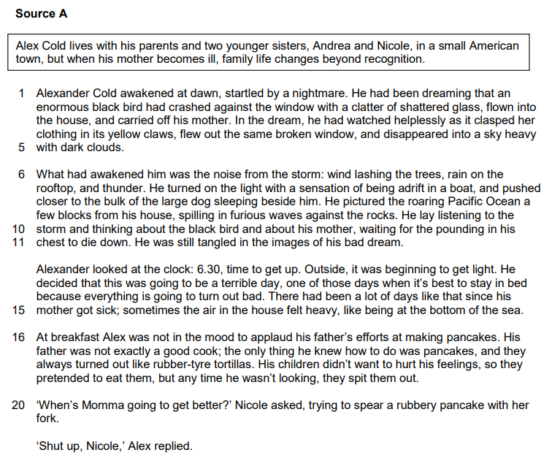
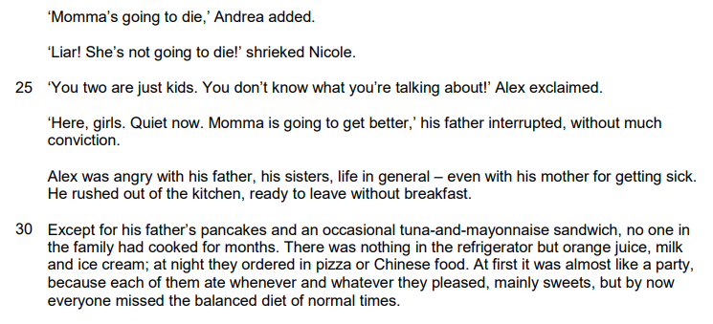
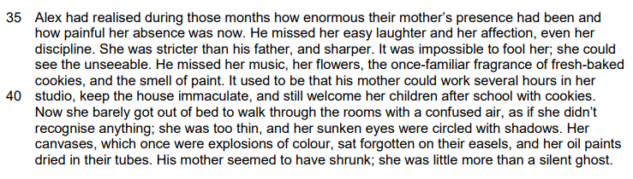
Source A
The Extract: Alex Cold

Slide 4

Question 1
4 marks =
5 minutes
List 4 things
Question 1: Top Tips
Write in full sentences
You can use direct quotes
Only select evidence linked to the question and the section of the text the question is referring to.
Alexander Cold awakened at dawn, startled by a nightmare. He had been dreaming that an enormous black bird had crashed against the window with a clatter of shattered glass, flown into the house, and carried off his mother. In the dream, he had watched helplessly as it clasped her clothing in its yellow claws, flew out the same broken window, and disappeared into a sky heavy with dark clouds.
0 1 Read again the first part of the source from lines 1 to 5.
List four things about the bird in Alex’s nightmare from this part.
[4 marks]
1.
2.
3.
4.

Slide 5

Question 2
8 marks =
10 minutes
Language Analysis
Question 2: Top Tips
Underline the key words in the question so you know to refer to it.
Analyse at least 3-4 short and relevant quotations in detail.
Show you understand the writer’s use of language
Zoom in on more than one language feature.
Zoom in on more that one key word.
Use correct subject terminology: personification, metaphor, simile, pathetic fallacy, dynamic verbs, alliteration, sibilance, imagery, adjectives, adverbs, preposition, modal verbs, asyndetic listing, auditory imagery, motif, zoomorphism
0 2 | Look in detail at this extract.
What had awakened him was the noise from the storm: wind lashing the trees, rain on the rooftop, and thunder. He turned on the light with a sensation of being adrift in a boat, and pushed closer to the bulk of the large dog sleeping beside him. He pictured the roaring Pacific Ocean a few blocks from his house, spilling in furious waves against the rocks. He lay listening to the storm and thinking about the black bird and about his mother, waiting for the pounding in his chest to die down. He was still tangled in the images of his bad dream.
Look in detail at this extract from lines 6 to 11 of the source.
How does the writer use language here to describe the effects of the storm?
You could include the writer’s choice of:
words and phrases
language features and techniques
sentence forms.
[8 marks]

Slide 6
Question 2
8 marks =
10 minutes
Mark Scheme
Level 4 Perceptive, detailed Shows detailed and perceptive understanding of language 7-8 marks | Analyses the effects of the writer’s choices of language Selects a range of judicious quotations Uses sophisticated subject terminology accurately
Level 3 Clear, relevant Shows clear understanding of language 5-6 marks | Clearly explains the effects of the writer’s choices of language Selects a range of relevant quotations Uses subject terminology accurately
Level 2 Some, attempts Shows some understanding of language 3-4 marks | Attempts to comment on the effect of language Selects some relevant quotations Uses some subject terminology, not always appropriately
Level 1 Simple, limited Shows simple awareness of language 1-2 marks | Offers simple comment on the effect of language Simple references or textual details Simple of subject terminology

Slide 7
Question 2
8 marks =
10 minutes
Language Analysis
Model Paragraph
The writer uses violent imagery to convey grief and loss through the effects of the storm in Alex’s dream. In particular, the violent verb ‘tangled’ has connotations of entrapment and immobility which has been caused by the storm. The fact that the storm has made Alex feel this way shows that it has a lot of power, is superior and physically dominant, but also echoes how it mirrors his own emotions as he experiences his own unsettling grief. Furthermore, the writer uses personification and present tense verbs to portray the violence that the storm carried with it. The wind is described as violently ‘lashing’ the trees to personify the storm as an angry, vicious attacker in its attempt to destroy the trees and nature. This illustrates that the storm is almost predatorial, deliberately trying to create pain and suffering, as it continues ‘spilling in furious waves against the rocks’ in an outlashing against the setting.
________________________________________________________________________________________________________________________________________________________________________________________________________________________________________________________________________________________________________________________________________________________________________________________________________________________________________________________________________________________________________________________________________________________________________________________________________________________________________________________________________________________________________________________________________________________________________________________________________________________________________________________________________________________________________________________________________________________________________________________________________________________________________________________________________________________________________________________________________________________________________________________________________________________________________________________________________________________________________________________________________________________________________________________________________________________________________________________________________________________________________________________________________________________________________________________________________________________________________________________________________________________________________________________________________________________________________________________________________________________________________________________________________________________________________________________________________________________________________________________________________________________________________________________________________________________________________________________________________________________________________________________________________________________________________________________________________________________________________________________________________________________________________________________________________________________________________________________________________________________________________________________________________________________________________________________________________________________________________________________________________________________________________________________________________________________________

Slide 8

Question 3
8 marks =
10 minutes
Structure Analysis
Question 3: Top Tips
Structure is about the way the ideas are ORGANISED across the whole text.
Show you understand STRUCTURAL features.
Examine and analyse the effects of the writer’s choice of structural features
Select and use relevant examples
Use appropriate subject terminology to discuss structure Structural features can be: At a whole text level – for example beginnings (exposition, setting) middle (problem, rising tension, conflict), endings (circular, open ended, cliff hanger) and shifts in focus. At a paragraph level – for example topic changes, dialogue, single-sentence paragraphs. At a sentence level – for example sentence lengths.
Avoid picking out sentence structures and punctuation.
The exam board is more interested in your ability to track the story – where does it go? How does it grab your attention? What changes and why?
Ensure that you are talking about FOCUS SHIFTS and how this changes between the beginning, middle and end.
You now need to think about the whole of the source.
This text is taken from the beginning of a novel.
How is the text structured to interest you as a reader?
You could write about:
what the writer focuses your attention on at the beginning
how and why the writer changes this focus as the source develops
any other structural features that interest you.
[8 marks]

Slide 9
Question 3
8 marks =
10 minutes
Mark Scheme
Level 4 Perceptive, detailed Shows detailed and perceptive understanding of structural features 7-8 marks | Analyses the effects of the writer’s choices of structural features Selects a range of judicious examples Uses a range of subject terminology appropriately
Level 3 Clear, relevant Shows clear understanding of structural features 5-6 marks | Clearly explains the effects of the writer’s choices of structural features Selects a range of relevant examples Uses subject terminology accurately
Level 2 Some, attempts Shows some understanding of structural features 3-4 marks | Attempts to comment on the effect of structural features Selects some relevant examples Uses some subject terminology, not always appropriately
Level 1 Simple, limited Shows simple awareness of structural features 1-2 marks | Offers simple comment on the effect of structure Simple references or examples Simple mention of subject terminology

Slide 10
Question 3
8 marks =
10 minutes
Structure Analysis
Model Paragraph
In the exposition, the writer uses a third person narrator to focus the reader’s attention on the immediate introduction to Alex and his nightmare, which foreshadows the deep and sincere changes that are occurring within his life. The writer deliberately uses setting to present the unsettled emotions that Alex is internally experiencing, projecting these onto the external setting to suggest that Alex’s life is in turmoil. Furthermore, also in the opening, the writer briefly focus shifts to the immense power of the storm outside which may link to his dreams and the thoughts he is experiencing in his own mind. The reader therefore is made aware of Alex’s own grief as it is reflected in the opening imagery of the storm and nightmare, foreboding Alex’s mother’s death as he struggles to cope with the situation.
________________________________________________________________________________________________________________________________________________________________________________________________________________________________________________________________________________________________________________________________________________________________________________________________________________________________________________________________________________________________________________________________________________________________________________________________________________________________________________________________________________________________________________________________________________________________________________________________________________________________________________________________________________________________________________________________________________________________________________________________________________________________________________________________________________________________________________________________________________________________________________________________________________________________________________________________________________________________________________________________________________________________________________________________________________________________________________________________________________________________________________________________________________________________________________________________________________________________________________________________________________________________________________________________________________________________________________________________________________________________________________________________________________________________________________________________________________________________________________________________________________________________________________________________________________________________________________________________________________________________________________________________________________________________________________________________________________________________________________________________________________________________________________________________________________________________________________________________________________________________________________________________________________________________________________________________________________________________________________________________________________________________________________________________________________________________

Slide 11
Question 4
20 marks =
20 minutes
Evaluation
Question 4: Top Tips
Identify the key opinions in the given statement. Find evidence from the identified section to support.
identify language and structural features;
Use precise quotations from the text to demonstrate these features;
analyse how the quotation proves your point;
evaluate how successfully this achieves the effect from the question;
focus on the specifics of the question
provide your own clear opinion of how far you agree with the statement in the question.
The Examiners’ Report says…
They agree, partially agree, disagree entirely.
What we’re looking for is a personal judgement which is informed and evidenced through references to the text.
Successful answers often take a method-based approach. Method-based answers begin with phrases such as, ‘The writer used the phrase/word ... to show how …’ and then continued with this approach throughout their answer.
Focus this part of your answer on the second half of the source from line 16 to the end.
A student said, ‘This part of the story, set during breakfast time, shows that Alex is struggling to cope with his mother’s illness.’
To what extent do you agree?
In your response, you could:
consider your own impressions of Alex
evaluate how the writer shows that Alex is struggling to cope
support your response with references to the text.
[20 marks]

Slide 12
Question 4
20 marks =
20 minutes
Mark Scheme
Level 4 Perceptive, detailed evaluation Shows perceptive and detailed evaluation 16-20 marks | Evaluates critically and in detail the effect(s) on the reader Shows perceptive understanding of writer’s methods Selects a judicious range of textual detail Develops a convincing and critical response to the focus of the statement
Level 3 Clear, relevant evaluation Shows clear and relevant evaluation 11-15 marks | Evaluates clearly the effect(s) on the reader Shows clear understanding of writer’s methods Selects a range of relevant textual references Makes a clear and relevant response to the focus of the statement
Level 2 Some evaluation Shows some attempts at evaluation 6-10 marks | Makes some evaluative comment(s) on effect(s) on the reader Shows some understanding of writer’s methods Selects some appropriate textual reference(s) Makes some response to the focus of the statement
Level 1 Simple, limited evaluation Shows simple, limited evaluation 1-5 marks | Makes simple, limited evaluative comment(s) on effect(s) on reader Shows limited understanding of writer’s methods Selects simple, limited textual reference(s) Makes a simple, limited response to the focus of the statement

Slide 13
Question 4
20 marks =
20 minutes
Evaluation
Model Paragraph
I wholeheartedly agree that Alexander is struggling to cope with his mother’s illness This is evident during Alexander’s exclamatory outburst at his sister’s predictions about his mother dying where he says ‘You two are just kids. You don’t know what you’re talking about!’ which shows a sense of denial from Alexander. This also suggest that Alex is longing for a sense of normality from his past. The use of a repeated exclamations and forceful use of the pronoun ‘You’ could also be said that the inevitability of this prediction is similar to the storm as it is impossible to stop a storm by simply denying its existence as Alex is trying to do with his mother’s illness. Furthermore, this is also demonstrated when Andrea explicitly states that ‘Momma’s going to die’ as he seeks any attempt to retract or move away from facing the realisation of reality by deliberately ignoring his sister’s use of dysphemism.
________________________________________________________________________________________________________________________________________________________________________________________________________________________________________________________________________________________________________________________________________________________________________________________________________________________________________________________________________________________________________________________________________________________________________________________________________________________________________________________________________________________________________________________________________________________________________________________________________________________________________________________________________________________________________________________________________________________________________________________________________________________________________________________________________________________________________________________________________________________________________________________________________________________________________________________________________________________________________________________________________________________________________________________________________________________________________________________________________________________________________________________________________________________________________________________________________________________________________________________________________________________________________________________________________________________________________________________________________________________________________________________________________________________________________________________________________________________________________________________________________________________________________________________________________________________________________________________________________________________________________________________________________________________________________________________________________________________________________________________________________________________________________________________________________________________________________________________________________________________________________________________________________________________________________________________________________________________________________________________________________________________________________________________________________________________________

Slide 14
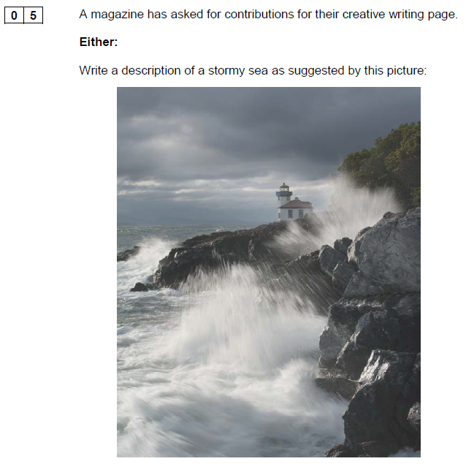
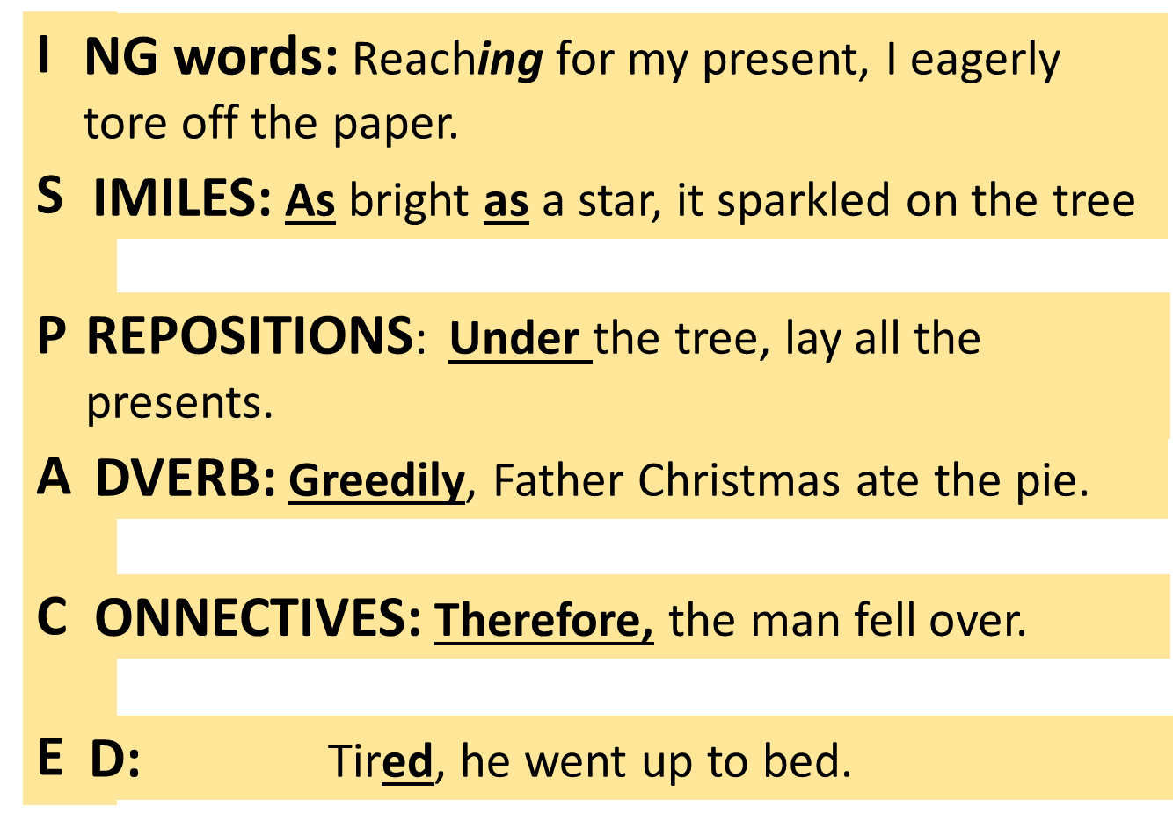
Question 5
40 marks =
45 minutes
Writing a Crafted Description
Reminder: Varying your sentence openers using ISPACE

Slide 15
______________________________________________________________________________________________________________________________________________________________________________________________________________________________________________________________________________________________________________________________________________________________________________________________________________________________________________________________________________________________________________________________________________________________________________________________________________________________________________________________________________________________________________________________________________________________________________________________________________________________________________________________________________________________________________________________________________________________________________________________________________________________________________________________________________________________________________________________________________________________________________________________________________________________________________________________________________________________________________________________________________________________________________________________________________________________________________________________________________________________________________________________________________________________________________________________________________________________________________________________________________________________________________________________________________________________________________________________________________________________________________________________________________________________________________________________________________________________________________________________________________________________________________________________________________________________________________________________________________________________________________________________________________________________________________________________________________________________________________________________________________________________________________________________________________________________________________________________________________________________________________________________________________________________________________________________________________________________________________________________________________________________________________________________________________________________________________________________________________________________________________________________________________________________________________________________________________________________________________________________________________________________________________________________________________________________________________________________________________________________________________________________________________________________________________________________________________________________________________________________________________________________________________________________________________________________________________________________________________________________________________________________________________________________________________________________________________________________________________________________________________________________________________________________________________________________________________________________________________________________________________________________________________________________________________________________________________________________________________________________________________________________________________________________________________________________________________________________________________________________________________________________________________________________________________________________________________________________________________________________________________________________________________________________________________________________________________________________________________________________________________________________________________________________________________________________________________________________________________________________________________________________________________________________________________________________________________________________________________________________________________________________________________________________________________________________________________________________________________________________________________

Slide 16



