Slide 1






Literature
Macbeth, An Inspector Calls
& A Christmas Carol
Mixed Student
Revision Guide

Slide 2

Section 1: Macbeth
By William Shakespeare

Slide 3

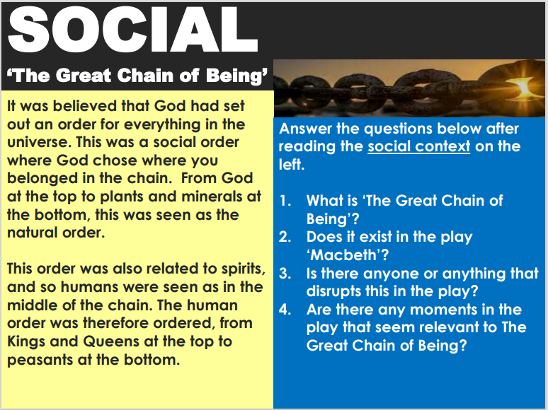
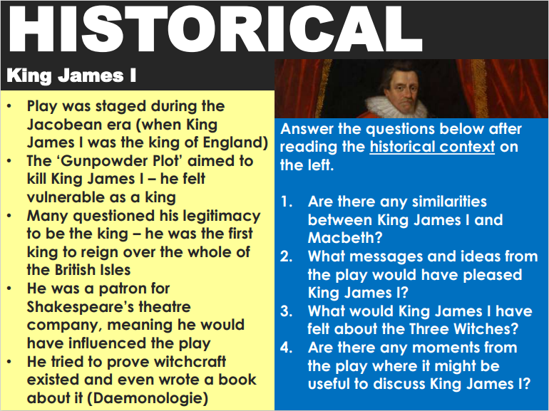
AO3: Context
TASK: For each aspect of context for Macbeth below, use the information and your own retrieval to answer all questions.

Slide 4

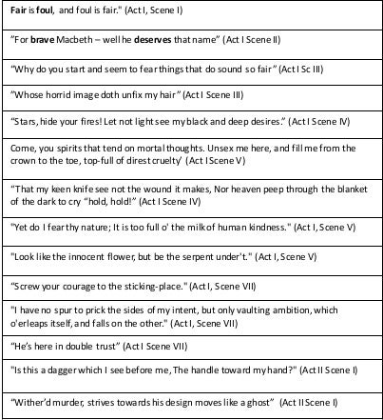

AO2: Methods & Analysis
TASK: For each of the following quotations, consider the following:
- What does the quotation mean and suggest?
- What devices are used by Shakespeare?
- What is the purpose and Shakespeare’s intentions?
TASK: Consider the following motifs in the play. Make notes on each one based on where it appears and which characters each applies to. Link to Shakespeare’s intentions and context.
Hands
Gender
Sleep
Blood
Light &
Dark
Nature

Slide 5
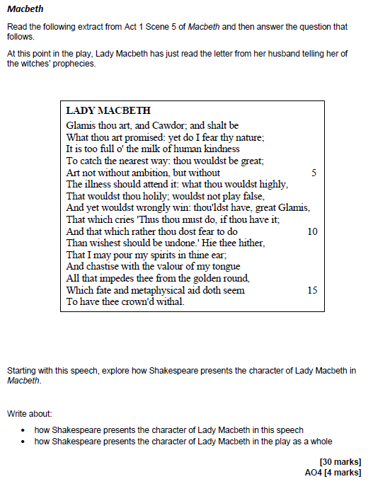
Exam Question

Slide 6
______________________________________________________________________________________________________________________________________________________________________________________________________________________________________________________________________________________________________________________________________________________________________________________________________________________________________________________________________________________________________________________________________________________________________________________________________________________________________________________________________________________________________________________________________________________________________________________________________________________________________________________________________________________________________________________________________________________________________________________________________________________________________________________________________________________________________________________________________________________________________________________________________________________________________________________________________________________________________________________________________________________________________________________________________________________________________________________________________________________________________________________________________________________________________________________________________________________________________________________________________________________________________________________________________________________________________________________________________________________________________________________________________________________________________________________________________________________________________________________________________________________________________________________________________________________________________________________________________________________________________________________________________________________________________________________________________________________________________________________________________________________________________________________________________________________________________________________________________________________________________________________________________________________________________________________________________________________________________________________________________________________________________________________________________________________________________________________________________________________________________________________________________________________________________________________________________________________________________________________________________________________________________________________________________________________________________________________________________________________________________________________________________________________________________________________________________________________________________________________________________________________________________________________________________________________________________________________________________________________________________________________________________________________________________________________________________________________________________________________________________________________________________________________________________________________________________________________________________________________________________________________________________________________________________________________________________________________________________________________________________________________________________________________________________________________________________________________________________________________________________________________________________________________________________________________________________________________________________________________________________________________________________________________________________________________________________________________________________________________________________________________________________________________________________________________________________________________________________________________________________________________________________________________________________________________________________________________________________________________________________________________________________________________________________________________________________________________________________________________________________________

Slide 7

Section 2: An Inspector Calls
By J.B. Priestley

Slide 8


AO3: Context
J.B. Priestley
Socialist Industrial Bradford |  | Priestley was born in 1894 in Bradford, Yorkshire. Bradford was an industrial town with a strong Socialist tradition. Priestley himself worked in the wool trade and noticed the poverty and injustice in Bradford.
First World War |  | When the First World War broke out in 1914, Priestley (aged twenty) joined and served for five years. Although the war led to some increase in social equality, he was traumatised by war and resentful towards the bourgeoisie ‘officer class’, who he blamed for ‘killing’ his ‘friends’.
Broadcasting |  | During the Second World War, Priestley broadcast his point of view on a BBC Radio Show, Postscripts. He wanted a better, fairer society where ‘free men could combine’ and where each ‘gives according to his ability and receives according to his need’. The show was cancelled after nine weeks.
Socialist Russia |  | An Inspector Calls was first performed in Moscow, Russia, after no London theatres would put it on. The play’s socialist message meant that audiences thought it was ‘realistic Soviet art’.
TASK: For each heading below, using the information on Priestley’s contextual influences above, create your own revision notes on the historical and social factors relating to the morality play.
PATRIARCHY
SOCIALISM
1912
CAPITALISM
1945
WOMEN
WORKERS

Slide 9
AO2: Methods & Analysis
TASK: For each of the following quotations, consider the following:
- What does the quotation mean and suggest?
- What devices are used by Priestley?
- What is the purpose and Priestley’s intentions?
Mr Birling
‘heavy looking, rather portentous man’
‘a hard‐headed practical man of business’
‘Yes, my dear, I know – I’m talking too much.’
‘perhaps we may look forward to a time when Crofts and Birlings are no longer competing but are working together’
‘The Germans don’t want war’
‘unsinkable, absolutely unsinkable’
‘mixed up together like bees in a hive’
‘community and all that nonsense’
‘a man has to mind his own business and look out for himself and his own.’
‘she’d had a lot to say – far too much – so she had to go of course.’
Mrs Birling
‘Arthur, you’re not supposed to say such things.’
(To Sheila) ‘when you’re married, you’ll realise that men with important work to do sometimes have to spend all their time and energy on their business.
‘You’ll have to get used to that, just as I had.’
‘We’ve done a great deal of useful work in helping deserving causes.’
‘I didn’t like her manner. She impertinently made use of our name.’
‘I did nothing I’m ashamed of.’
‘I blame the young man. He ought to be dealt with very severely.’

Slide 10
AO2: Methods & Analysis
Eric
‘I was in that state when a chap easily turns nasty.’
‘You’re not the kind of father a chap could go to when he’s in trouble. That’s why.’
‘You killed her – and the child she’d have had too – my child’
‘You’re beginning to pretend as if nothing’s really happened at all. And I can’t see it like that. The girl’s still dead, isn’t she?’
Sheila
‘But these girls aren’t cheap labour – they’re people.’
‘I felt rotten about it at the time and now I feel a lot worse.’
‘She was very pretty and looked like she could take care of herself.’
‘I hate to think how much he knows that we don’t know yet.’
‘I know I’m to blame and I’m desperately sorry.’
Gerald
(To Sheila) ‘I hope I can make you as happy as you deserve to be.’
‘My God! ...I’ve suddenly realized – taken it in properly – that she’d dead!’
‘I didn’t install her there so I could make love to her.’
‘I didn’t feel about her as she felt about me.’
The Inspector
‘We have to share something. If there’s nothing else, we have to share our guilt.’
‘One Eva Smith has gone – but there are millions and millions and millions of Eva Smiths and John Smiths left with us.’
‘We don’t live alone. We are members of one body. We are responsible for each other.’
‘they will be taught it in fire and blood and anguish.’

Slide 11
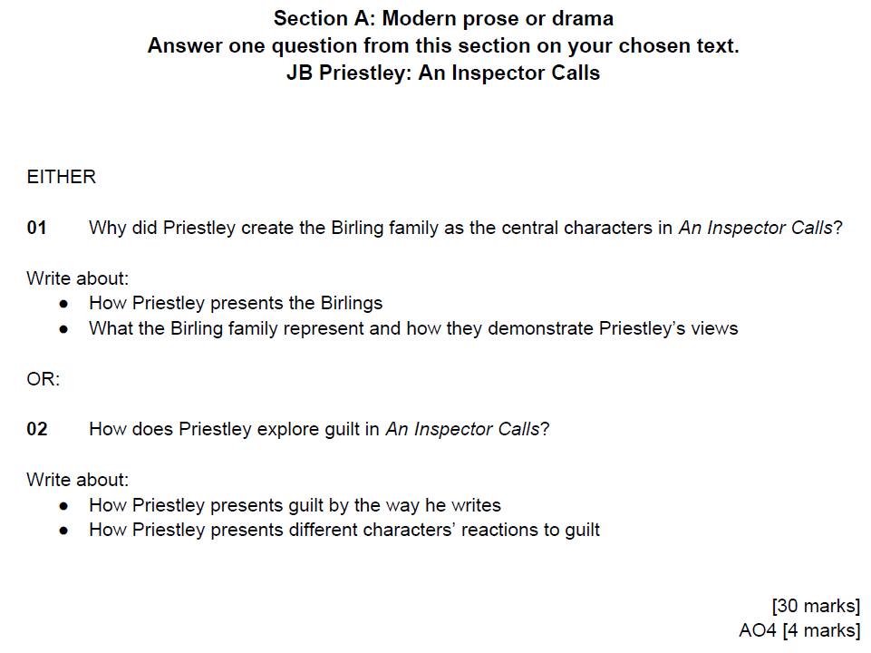
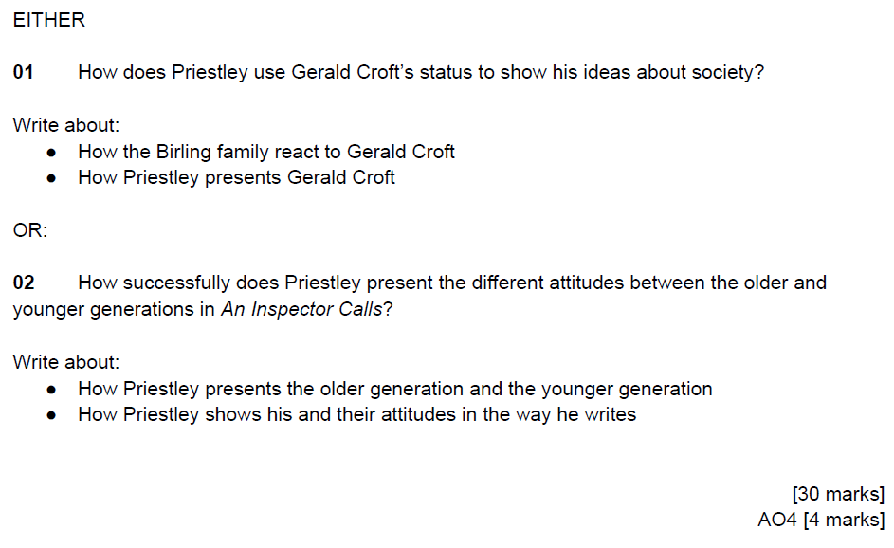
Exam Question

Slide 12
______________________________________________________________________________________________________________________________________________________________________________________________________________________________________________________________________________________________________________________________________________________________________________________________________________________________________________________________________________________________________________________________________________________________________________________________________________________________________________________________________________________________________________________________________________________________________________________________________________________________________________________________________________________________________________________________________________________________________________________________________________________________________________________________________________________________________________________________________________________________________________________________________________________________________________________________________________________________________________________________________________________________________________________________________________________________________________________________________________________________________________________________________________________________________________________________________________________________________________________________________________________________________________________________________________________________________________________________________________________________________________________________________________________________________________________________________________________________________________________________________________________________________________________________________________________________________________________________________________________________________________________________________________________________________________________________________________________________________________________________________________________________________________________________________________________________________________________________________________________________________________________________________________________________________________________________________________________________________________________________________________________________________________________________________________________________________________________________________________________________________________________________________________________________________________________________________________________________________________________________________________________________________________________________________________________________________________________________________________________________________________________________________________________________________________________________________________________________________________________________________________________________________________________________________________________________________________________________________________________________________________________________________________________________________________________________________________________________________________________________________________________________________________________________________________________________________________________________________________________________________________________________________________________________________________________________________________________________________________________________________________________________________________________________________________________________________________________________________________________________________________________________________________________________________________________________________________________________________________________________________________________________________________________________________________________________________________________________________________________________________________________________________________________________________________________________________________________________________________________________________________________________________________________________________________________________________________________________________________________________________________________________________________________________________________________________________________________________________________________________________________

Slide 13

Section 3: A Christmas Carol
By Charles Dickens

Slide 14
AO3: Context
TASK: Make ‘brain dump’ notes on each aspect of historical context from the Victorian era below. This is a crucial aspect of your Literature essay writing skills that all analysis of language needs to be linked back to.
The Poor Law Amendment | Christmas & Christianity
The purpose of the text | Industrial Revolution
Power | Dickens’ life

Slide 15

AO2: Methods & Analysis
TASK: Consider the decluttered description of Scrooge. Think about how Dickens uses language to present Scrooge. Annotate around the description with your ideas including language devices/word classes.
a tight-fisted
squeezing, wrenching
old sinner
secret and self contained
solitary as an oyster
old features
pointed nose
eyes red
thin lips blue
grating voice
a wiry chin
TASK: For each of the following quotations, consider the following:
- What does the quotation mean and suggest?
- What devices are used by Dickens?
- What is the purpose and Dickens’ intentions?
“If they would rather die,” said Scrooge, “they had better do it, and decrease the surplus population.”
‘Piercing, searching, biting cold.’
‘Scrooge took his melancholy dinner in his usual melancholy tavern.’

Slide 16






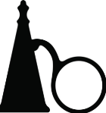
AO2: Methods & Analysis
TASK: Consider the following images and make notes around them on how they link to Marley’s ghost, the message he brings with him for Scrooge, Scrooge’s younger and childhood past and The Ghost of Christmas Past.

Slide 17
Exam Question

Slide 18
______________________________________________________________________________________________________________________________________________________________________________________________________________________________________________________________________________________________________________________________________________________________________________________________________________________________________________________________________________________________________________________________________________________________________________________________________________________________________________________________________________________________________________________________________________________________________________________________________________________________________________________________________________________________________________________________________________________________________________________________________________________________________________________________________________________________________________________________________________________________________________________________________________________________________________________________________________________________________________________________________________________________________________________________________________________________________________________________________________________________________________________________________________________________________________________________________________________________________________________________________________________________________________________________________________________________________________________________________________________________________________________________________________________________________________________________________________________________________________________________________________________________________________________________________________________________________________________________________________________________________________________________________________________________________________________________________________________________________________________________________________________________________________________________________________________________________________________________________________________________________________________________________________________________________________________________________________________________________________________________________________________________________________________________________________________________________________________________________________________________________________________________________________________________________________________________________________________________________________________________________________________________________________________________________________________________________________________________________________________________________________________________________________________________________________________________________________________________________________________________________________________________________________________________________________________________________________________________________________________________________________________________________________________________________________________________________________________________________________________________________________________________________________________________________________________________________________________________________________________________________________________________________________________________________________________________________________________________________________________________________________________________________________________________________________________________________________________________________________________________________________________________________________________________________________________________________________________________________________________________________________________________________________________________________________________________________________________________________________________________________________________________________________________________________________________________________________________________________________________________________________________________________________________________________________________________________________________________________________________________________________________________________________________________________________________________________________________________________________________________________________

Slide 19



