Slide 1



‘Macbeth’
By William Shakespeare
Revision Masterclass Notebook

Slide 2
What does the question look like?
Literature Paper 1 – The Shakespeare (Macbeth) question will be first – Section A
AO1 | Read, understand and respond to texts. Students should be able to: maintain a critical style and develop an informed personal response; use textual references, including quotations, to support and illustrate interpretations.
AO2 | Analyse the language, form and structure used by a writer to create meanings and effects, using relevant subject terminology where appropriate.
AO3 | Show understanding of the relationships between texts and the contexts in which they were written.
AO4 | Use a range of vocabulary and sentence structures for clarity, purpose and effect, with accurate spelling and punctuation.
Assessment Objectives:
These are the skills that an examiner will be looking for.
Note: You are marked on SPAG for the Shakespeare question
The exam is 1 hour 45 minutes (2 hours 10 minutes if you are given extra time) long.
Spend 1 hour on Section A – Macbeth (Shakespeare play) and 45 minutes on Section B – A Christmas Carol (19th Century novel).
Breakdown of exam timings:
10 minutes – Read the question and the extract; annotate your extract and plan your answer
45 minutes – Writing your response
5 minutes – Proof reading your work
NOTE: It is not enough to just mention the methods used by Shakespeare; you must comment on why he has used them and what they allow the audience to think/feel or understand about the selected character or theme in detail.
IMPORTANT: Macbeth is a play and would be watched by an AUDIENCE – NOT A READER!

Slide 3
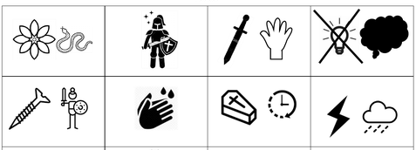
Do Now: Retrieval Practise
TASK: Answer the following questions and then identify the quotations that match the icons.
Why can Macbeth be seen as royalist propaganda? | What is Macbeth’s hamartia? | Who has their suspicions that Macbeth played ‘foully’ for the Kingship? | Why was King James I so interested in the supernatural?
What does the term ‘duplicity’ mean? | What does Lady Macbeth command ‘spirits’ to do to her? | Who was ‘from his mother’s womb untimely ripp’d’? | What does Lady Macbeth try and scrub from her hands in Act 5, Scene 1?

Slide 4


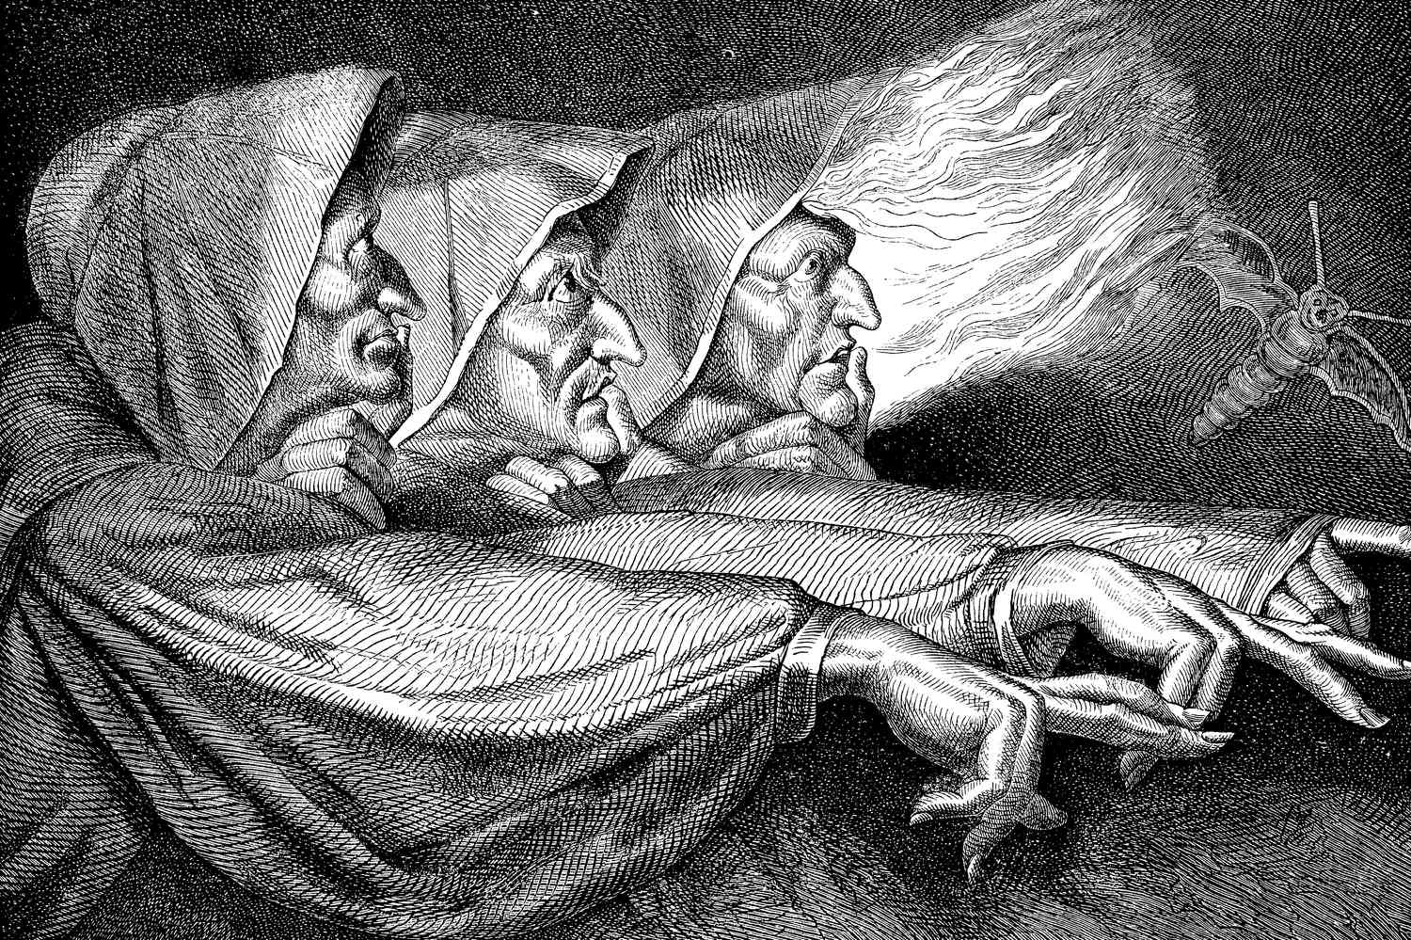
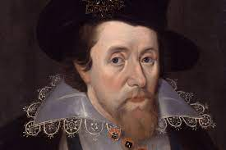
The Plot (AO1) & Context (AO3)
TASK: Complete the summary boxes for each Act below. Then, mind map what you know about each AO3 context heading.
Act One | Act Two | Act Three
Act Four | Act Five | Key Terms
Jacobean Era
King James I
Witchcraft
Divine Rights of Kings
The Great Chain of Being

Slide 5
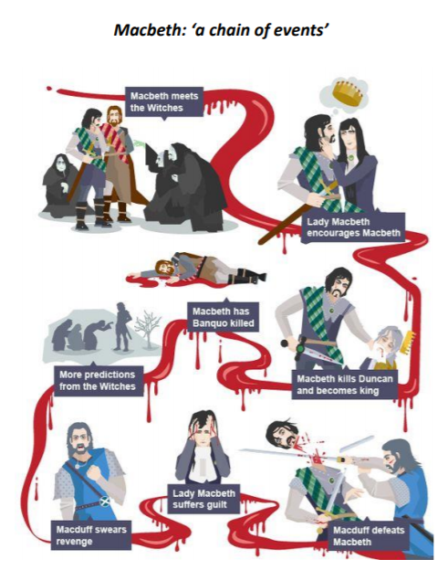
The Plot of ‘Macbeth’

Slide 6
Knowledge Organiser
Characters
Macbeth | Macbeth is a Scottish general and the thane of Glamis who is led by the prophecies of the three witches. Macbeth is a brave soldier and a powerful man, but he is not a virtuous one. He is easily tempted into murder to fulfil his ambitions to the throne, and once he commits his first crime and is crowned King of Scotland, he embarks on further atrocities with increasing ease. Ultimately, Macbeth proves himself better suited to the battlefield than to political intrigue, because he lacks the skills necessary to rule without being a tyrant. His response to every problem is violence and murder. He is unable to bear the psychological consequences of his atrocities.
Lady Macbeth | Macbeth’s wife, a deeply ambitious woman who lusts for power and position. Early in the play, she seems to be the stronger and more ruthless of the two, as she urges her husband to kill Duncan and seize the crown. After the bloodshed begins, however, Lady Macbeth falls victim to guilt and madness to an even greater degree than her husband. Her conscience affects her to such an extent that she eventually commits suicide.
The three witches | Three “black and midnight hags” who plot mischief against Macbeth using charms, spells, and prophecies. Their predictions prompt him to murder Duncan, to order the deaths of Banquo and his son, and to blindly believe in his own immortality. They clearly take a perverse delight in using their knowledge of the future to toy with and destroy human beings.
Banquo | Banquo is a friend of Macbeth and a fellow captain. Along with Macbeth, he has led the Scottish troops to victory. He is also given a prophecy by the witches. As he sees the prophecies come true for Macbeth, he begins to suspect his friend of evil deeds. Macbeth has him killed, but the ghost of Banquo continues to haunt Macbeth. Facts we learn about Banquo at the start of the play: He is a successful captain in Duncan’s army alongside Macbeth. He is curious about the witches’ prophecies for both himself and Macbeth. He has a son called Fleance.
Macduff | Macduff is the Thane of Fife?. He is married to Lady Macduff and has children. Macduff suspects Macbeth of killing Duncan, and joins with Malcolm to overthrow him. When Macduff's family is killed by Macbeth, he vows revenge. Macduff fights with Macbeth and kills him. Facts we learn about Macduff at the start of the play: He has a wife and children. He visits Macbeth’s castle in Inverness to meet with King Duncan. He is loyal to Duncan and does not go to Macbeth’s coronation
Duncan | Duncan is the King of Scotland. He has two sons, Malcolm and Donalbain. He trusts Macbeth and honours him with a new title and a visit to his castle. Whilst he is visiting, Macbeth murders him in his sleep. Facts we learn about Duncan at the start of the play: He is a well-liked and successful king. His army has just defeated the rebel Macdonald’s forces and the Norwegian troops. He has two sons, Malcolm and Donalbain. He shows gratitude to those loyal to him through praise, land and titles.
Playwright – William Shakespeare
1 | Macbeth is a play written around 1606 by William Shakespeare. Shakespeare was writing during the Renaissance. The Renaissance period was between 14th and 17th Centuries where there was an expansion of artistic expression. Shakespeare wrote ‘Macbeth’ during the reign of King James such as Macbeth were much more cynical and dark reflecting the insecurities of King James.
2 | Genre - Macbeth is a dramatic tragedy. It follows his classic 5 act structure. The tragedy surrounds the protagonists Macbeth and the witches act as a catalysts for the play’s events.
Key Concepts and Context
Hamartia - ‘Fatal flaw’ | A character’s fatal flaw is the thing that leads to their ultimate downfall – in Macbeth’s case it is his ambition and lust for power that led to his inevitable downfall and is the arc of play between him and his wife.
Catharsis - Purging | This is also an ancient Greek term that means ‘purging’ or ‘cleansing’ of emotions, particularly through pity and fear, the audience experiences at the end of a tragedy.
Divine right of kings | James I believed in the divine right of kings, so he believed that he was chosen by God to be the king of England and the righteous judge of England. He believed in witch trials and witch hunts not only out of moral conviction but due to the fact he was ordained by God.
Great Chain of Being | The king being closest to God on Earth. Because of this close relationship, it was the role of the king to enact the will of God which James I believed was to rid he earth of witchcraft.
Witchcraft | The Witches are clearly unlike any other characters in the play. Their physical appearance, their style of speech, their actions and their apparent ability to predict the future sets them apart from the humans they seek to control.

Slide 7
Exam Technique
In the following extract from Act 3, Scene 1, Macbeth is considering his relationship with Banquo and his new status as King of Scotland.
MACBETH:
To be thus is nothing;
But to be safely thus.--Our fears in Banquo
Stick deep; and in his royalty of nature
Reigns that which would be fear'd: 'tis much he dares; And, to that dauntless temper of his mind,
He hath a wisdom that doth guide his valour
To act in safety. There is none but he
Whose being I do fear: and, under him,
My Genius is rebuked; as, it is said,
Mark Antony's was by Caesar. He chid the sisters
When first they put the name of king upon me,
And bade them speak to him: then prophet-like
They hail'd him father to a line of kings:
Upon my head they placed a fruitless crown,
And put a barren sceptre in my gripe,
Thence to be wrench'd with an unlineal hand,
No son of mine succeeding. If 't be so,
For Banquo's issue have I filed my mind;
For them the gracious Duncan have I murder’d;
Put rancours in the vessel of my peace
Only for them; and mine eternal jewel Given to the common enemy of man,
To make them kings, the seed of Banquo kings!
Starting with this speech, explore how far Shakespeare presents Macbeth as a tragic hero.
• how Shakespeare presents him as a tragic hero in this scene
• how Shakespeare presents him as a tragic hero in the rest of the play.
[30 marks]
AO4 [4 marks]
Ideas

Slide 8
Model
At the beginning of the play, Macbeth is admired by many who look up to him for his bravery and loyalty to the king. In Act 1, Scene 2, the Captain describes Macbeth’s action to the king sparing no detail declaring him as a hero for helping to win the war against Norway. He states ‘with his brandished steel, which smoked with bloody execution’ which suggests that his sword was designed for the murder of others, and he is willing to put his life on the line for his King and country. The sensory verb ‘smoked’ further suggests the quickness of the fighting. Macbeth was so quick in his “execution” that the sword appeared to visibly smoke from it. For the audience, it can connote the enthusiasm of Macbeth in the fight – and because we haven’t yet met him, this is the only description we can gain of him. The epithet ‘brave’ Macbeth shows him to be heroic in the eyes of his comrades and king. The description of ‘brandished steel’ conveys the image of the sword and how prepared Macbeth was for this fight. ​
Shakespeare intention is to imply that Macbeth is a hero at the start of his tragedy play, he doesn’t shy away from violence in order to support the king. The effect on the audience would be that they admire his bravery and the Captain’s description enhances the idea that Macbeth is a heroic character. This also links to context as being a hero in war was consider the epitome of masculinity during the patriarchal society of the Jacobean Era. ​
Macbeth’s suspicions over Banquo also become evident in this soliloquy as he is shown to be restless and insecure. He is afraid that he might lose his position and is also frustrated by the fact that he has no heir. Without the knowledge that his lineage will continue after him, Macbeth finds it meaningless to be king. This quote: ‘To be thus is nothing; / But to be safely thus’ reveals how him giving in to his ambition and murdering Duncan has not brought him peace, but rather has just left him more paranoid and anxious. The line also reveals how Macbeth’s first violent action sets off a chain reaction of him continuing to commit violent actions in order to maintain his hold on the power he has gained.
Exam-Style Feedback & Notes – Areas of Strength & Improvement

Slide 9
You Do: Answering the Question
________________________________________________________________________________________________________________________________________________________________________________________________________________________________________________________________________________________________________________________________________________________________________________________________________________________________________________________________________________________________________________________________________________________________________________________________________________________________________________________________________________________________________________________________________________________________________________________________________________________________________________________________________________________________________________________________________________________________________________________________________________________________________________________________________________________________________________________________________________________________________________________________________________________________________________________________________________________________________________________________________________________________________________________________________________________________________________________________________________________________________________________________________________________________________________________________________________________________________________________________________________________________________________________________________________________________________________________________________________________________________________________________________________________________________________________________________________________________________________________________________________________________________________________________________________________________________________________________________________________________________________________________________________________________________________________________________________________________________________________________________________________________________________________________________________________________________________________________________________________________________________________________________________________________________________________________________________________________________________________________________________________________________________________________________________________________________________________________________________________________________________________________________________________________________________________________________________________________________________________________________________________________________________________________________________________________________________________________________________________________________________________________________________________________________________________________________________________________________________________________________________________________________________________________________________________________________________________________________________________________________________________________________________________________________________________________________________________________________________________________________________________________________________________________________________________________________________________________________________________________________________________________________________________________________________________________________________________________________________________________________________________________________________________________________________________________________________________________________________________________________________________________________________________________________________________________________________________________________________________________________________________________________________________________________________________________________________________________________________________________________________________________________________________________________________________________________________________________________________________________________________________________________________________

Slide 10




